Slide 1
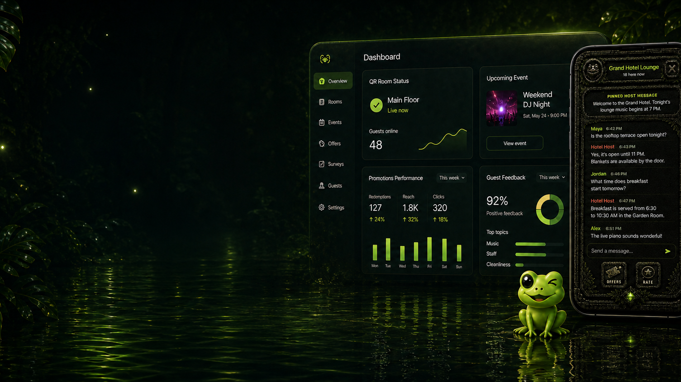

Turn your venue into
a live local experience.
One QR scan connects people to the conversation, updates, events, and experiences happening right where they are.
UNIVERSITIES • PARKS • LIBRARIES • HOTELS
Coqui | Funktastic Labs LLC
Notes:
Open with the simplest definition: Coqui gives a physical place its own lightweight digital room.
[Sources]
- C:\Users\LlanL\Documents\New project\apps\business-web\public\coqui-business-hero-unified-v3.png
- C:\Users\LlanL\Documents\New project\apps\business-web\public\coqui-logo-bright.png
- https://meetcoqui.com/
[/Sources]

Slide 2
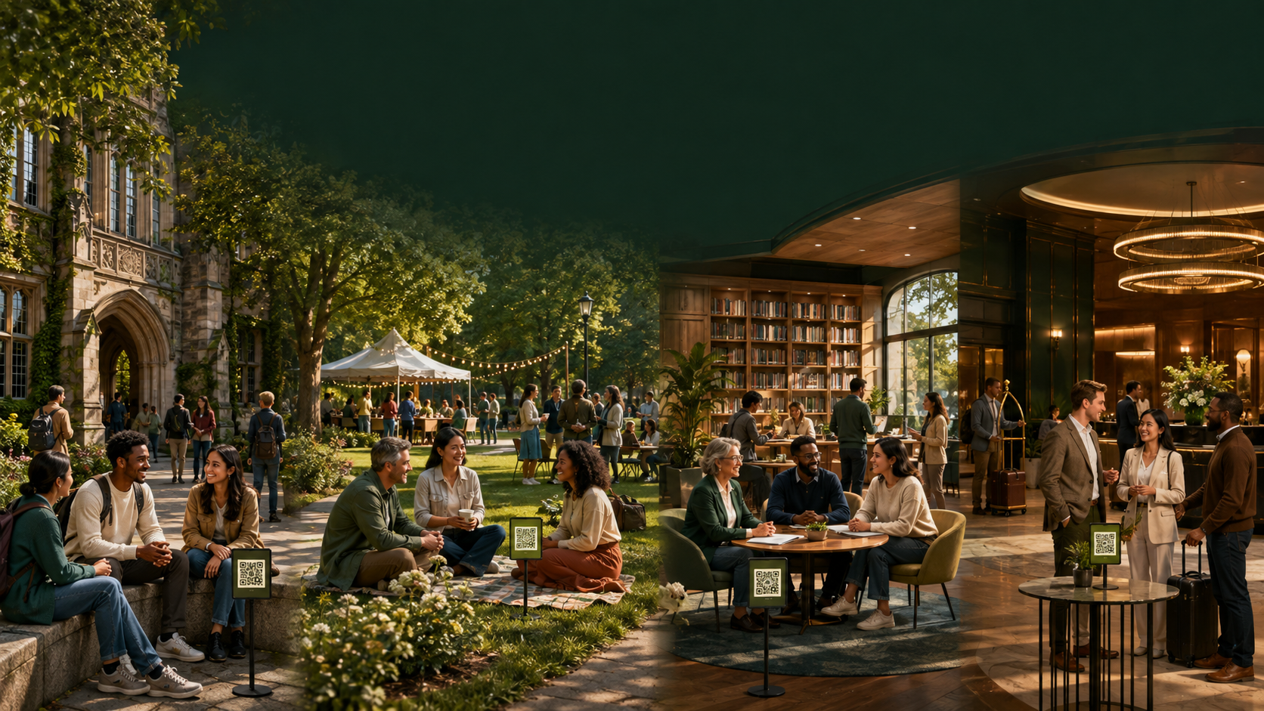
THE OPPORTUNITY
People share the same place.
They do not always share the moment.
Coqui gives the place a simple way to start the connection.
COQUI • 02
meetcoqui.com
Notes:
Use the four environments to show that the product is not limited to hospitality. The common denominator is a real place with people and a reason to connect.
[Sources]
- C:\Users\LlanL\Documents\New project\marketing\coqui-multi-venue-community-hero.png
- Generated with OpenAI image generation on 2026-09-03; prompt recorded in source-notes.txt
[/Sources]

Slide 3
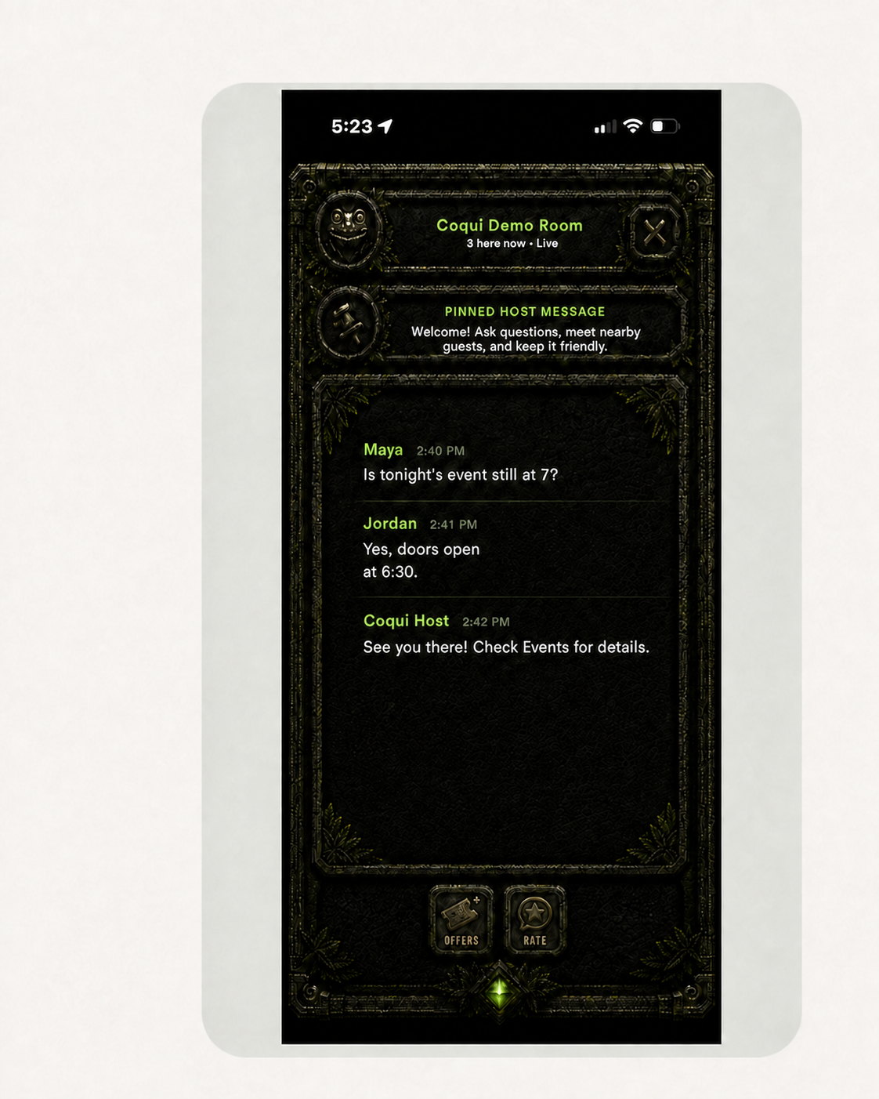
The whole guest journey fits in four steps.
No roster import or complicated public profile is required.
1
Scan
Open the QR room assigned to this physical space.
2
Verify nearby
Coqui checks the room token and the guest’s proximity.
3
Choose a local name
Enter with a temporary name for this room experience.
4
Join the room
See host updates and participate in the local conversation.
COQUI • 03
meetcoqui.com
Notes:
Emphasize that the entry flow is QR plus proximity, not an institutional identity integration. Chat currently uses API calls and short-interval REST polling.
[Sources]
- C:\Users\LlanL\Documents\New project\marketing\coqui-demo-room-generic-chat.png
- C:\Users\LlanL\Documents\New project\AGENTS.md
- https://meetcoqui.com/
[/Sources]

Slide 4
One idea. Four very different venue outcomes.
The room adapts to the purpose of the place.
U
P
L
H
University
Park
Library
Hotel
Welcome events, student organizations, residence communities, resource fairs, and shared campus spaces.
Festivals, programs, classes, trailhead updates, and community gatherings in a defined area.
Clubs, workshops, exhibits, civic resources, and program conversation without requiring a public profile.
Lobby, pool, lounge, conference, and event-floor updates, conversation, offers, and feedback.
The shared result: more timely information, more participation, and an easier path into the real-world experience.
COQUI • 04
meetcoqui.com
Notes:
These are use cases, not claimed customer outcomes. Choose the column that matches the audience and make the example concrete.
[Sources]
- https://meetcoqui.com/
- C:\Users\LlanL\Documents\New project\AGENTS.md
[/Sources]

Slide 5
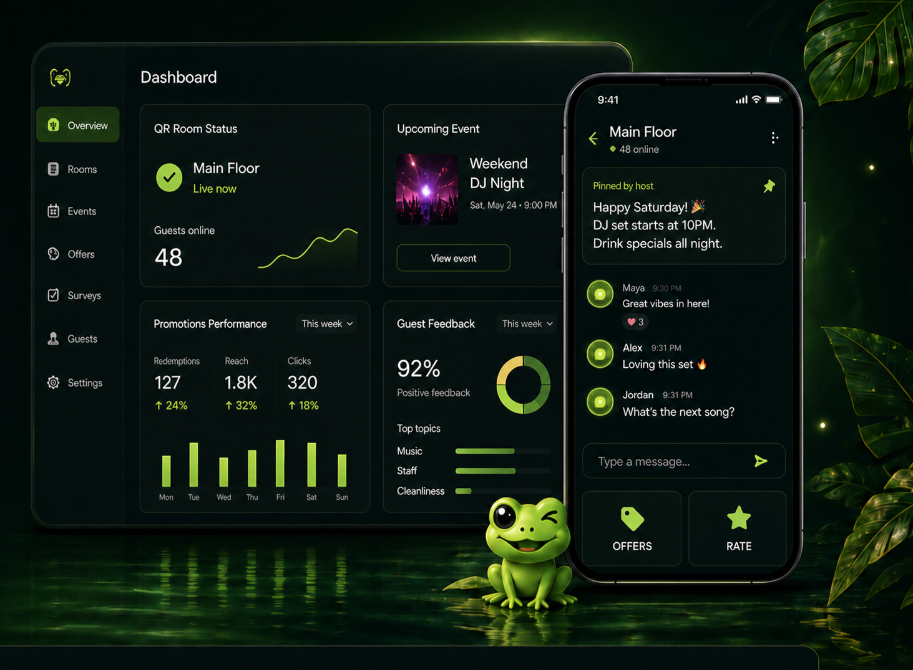
Guests get context without another heavy social network.
The room is local, temporary, and useful in the moment.
A host-led starting point
A pinned message tells everyone what matters now.
Local conversation
Guests can ask, answer, coordinate, and connect in the room.
More reasons to participate
Events, offers, feedback, and venue updates sit close to the experience.
Less identity overhead
Temporary local names avoid requiring an institutional public profile.
Coqui is designed to move people toward the place—not away from it.
COQUI • 05
meetcoqui.com
Notes:
Keep the value proposition grounded in the moment. Avoid describing Coqui as a replacement for a university app, hotel app, or social platform.
[Sources]
- C:\Users\LlanL\Documents\New project\apps\business-web\public\coqui-approved-product-hero-no-faces.png
- https://meetcoqui.com/
[/Sources]

Slide 6
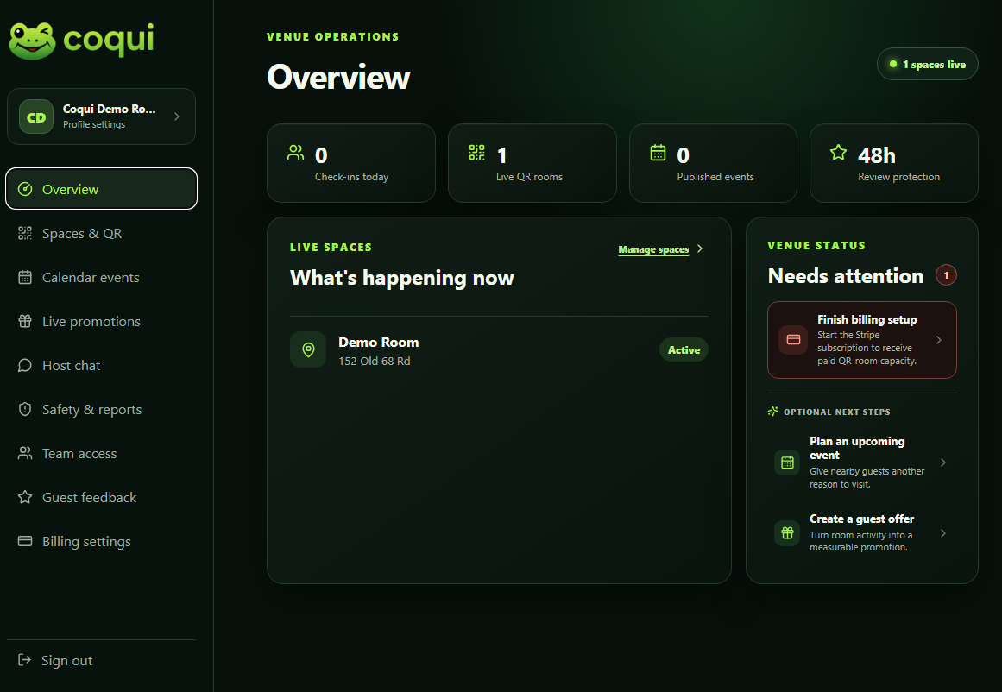
The venue guides the room—and the moment.
Operators get a focused workspace for each approved space.
01
Lead the conversation
Post as the host and pin the update everyone should see.
02
Manage the space
Pause, resume, clear, and organize approved QR rooms.
03
Respond to concerns
Review reports, remove content, and suspend a device for the room.
04
Keep the experience current
Publish room-specific events, promotions, and feedback prompts.
COQUI • 06
meetcoqui.com
Notes:
The owner portal is independently runnable today. Named moderators are institution-scoped and every host or moderation action is attributed to the signed-in account.
[Sources]
- C:\Users\LlanL\Documents\New project\marketing\coqui-venue-owner-portal-generic-host-chat-v2.png
- User-provided production-interface screenshot; room and conversation text anonymized with OpenAI image editing on 2026-09-03.
- C:\Users\LlanL\Documents\New project\AGENTS.md
- https://meetcoqui.com/
[/Sources]

Slide 7

A local room still needs serious safeguards.
Privacy and moderation are operating requirements, not decorative promises.
1
Bound the room
QR token validation and a GPS proximity check govern normal entry.
2
Limit identity collection
No roster, student ID, schedule, grade, or academic-record import is required.
3
Give people recourse
Guests can report messages; moderators can remove content or suspend the responsible device.
4
Make authority accountable
Named institutional moderators are tenant-scoped and actions are recorded under their names.
Accessibility approach: focused review and remediation before a pilot, using WCAG 2.2 Level AA as the engineering target.
COQUI • 07
meetcoqui.com
Notes:
Do not call the product FERPA-certified or WCAG-certified. The pilot structure can avoid institutional education-record disclosure, but the actual data flow and agreement must be reviewed by the institution.
[Sources]
- C:\Users\LlanL\Documents\New project\AGENTS.md
- https://meetcoqui.com/security
- https://www.w3.org/WAI/standards-guidelines/wcag/
[/Sources]

Slide 8
Ready for a real-world pilot—with a clear plan for growth.
Coqui’s essential features are ready today. During the pilot, we’ll test them in a real venue, gather feedback, and continue improving the experience.
REAL TODAY
CONTINUING HARDENING
A controlled venue pilot
Built to improve with the pilot
• Guests can join rooms by scanning a secure QR code
• Location checks help ensure guests are at the venue
• Messages and user reports are saved for review
• Hosts can manage chats, rooms, pins, and events
• Approved venue staff can moderate conversations
• Moderation actions are recorded for accountability
• Online billing and venue management portals are live
• Faster live messages and online-status updates
• More sign-in, account recovery, and security options
• A clearer process for moderation reviews and appeals
• An independent review of accessibility
• Stronger system monitoring and backup testing
• Upgraded data storage for long-term growth
The right first deployment is small, supervised, and measurable.
COQUI • 08
meetcoqui.com
Notes:
This slide prevents overclaiming. Chat is currently REST polling rather than WebSocket realtime. Several older stores retain JSON fallback behavior when a database is unavailable.
[Sources]
- C:\Users\LlanL\Documents\New project\AGENTS.md
[/Sources]

Slide 9
Start with one room and one reason to gather.
A good pilot answers a focused question before it asks for scale.
01
02
03
04
Choose
Agree
Configure
Learn
Select one location, event, and intended outcome.
Approve data, retention, moderation, and escalation rules.
Set the GPS boundary, QR room, host message, and named moderators.
Run a supervised test and review participation, reports, and feedback.
The decision after the pilot
Does this room help people connect, participate, and stay informed—while giving the venue enough control to operate it responsibly?
COQUI • 09
meetcoqui.com
Notes:
Do not prescribe a duration until the venue's event calendar and review requirements are understood. Define success before activation.
[Sources]
- C:\Users\LlanL\Documents\New project\AGENTS.md
[/Sources]

Slide 10
Give your place a voice—
without losing control.
Let’s choose one real space, define the safeguards, and see whether Coqui helps the moment come alive.
Llan Llanos • Founder, Coqui
330-304-8955 • llanllanos@outlook.com • meetcoqui.com
COQUI • 10
meetcoqui.com
Notes:
Close on a low-risk next step: a 20-minute demonstration and a conversation about one supervised use case.
[Sources]
- C:\Users\LlanL\Documents\New project\apps\business-web\public\coqui-mascot-polished-v1.png
- C:\Users\LlanL\Documents\New project\apps\business-web\public\coqui-logo-bright.png
- https://meetcoqui.com/
[/Sources]

